Slide 1
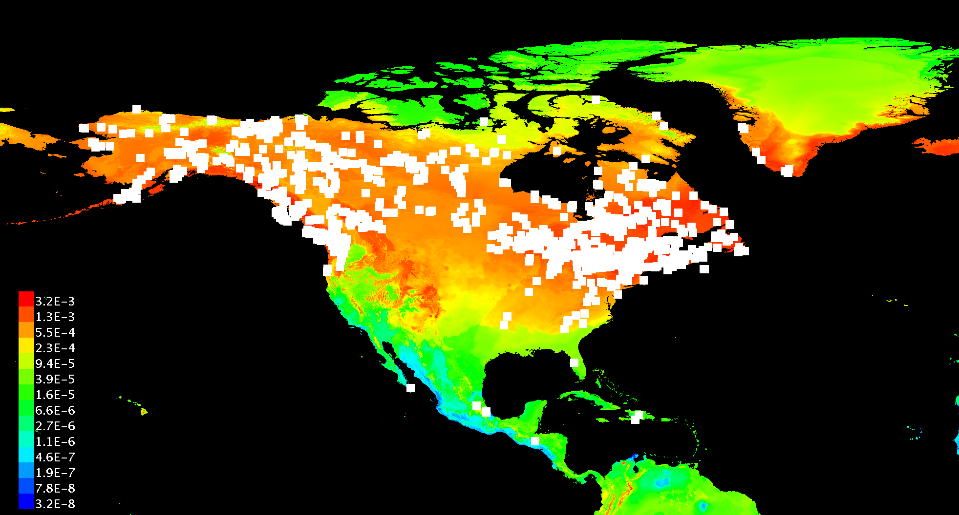
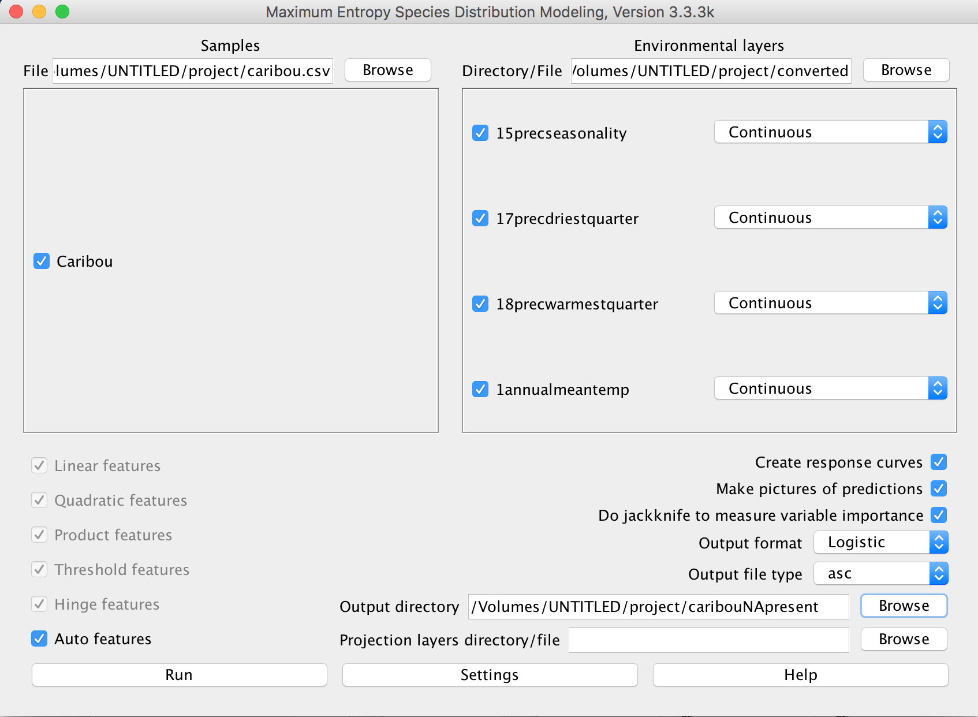
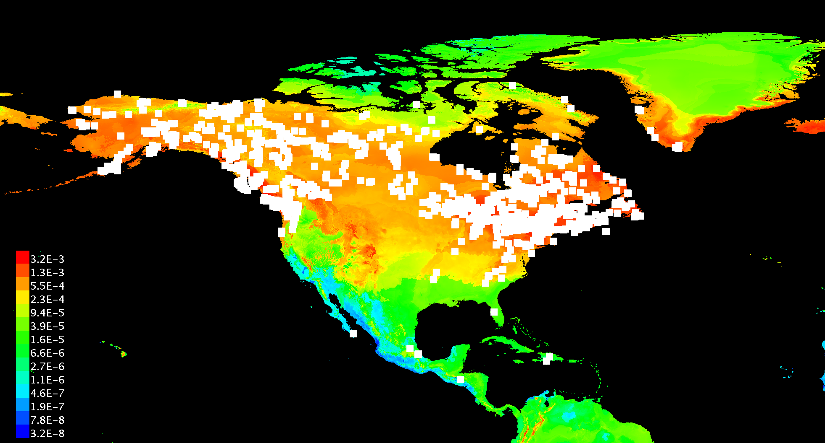
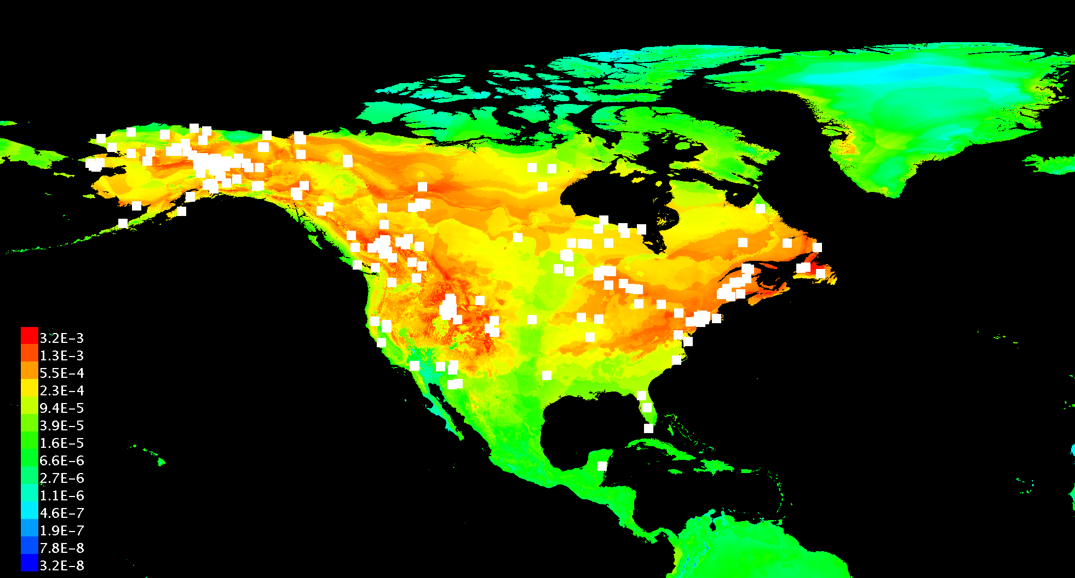
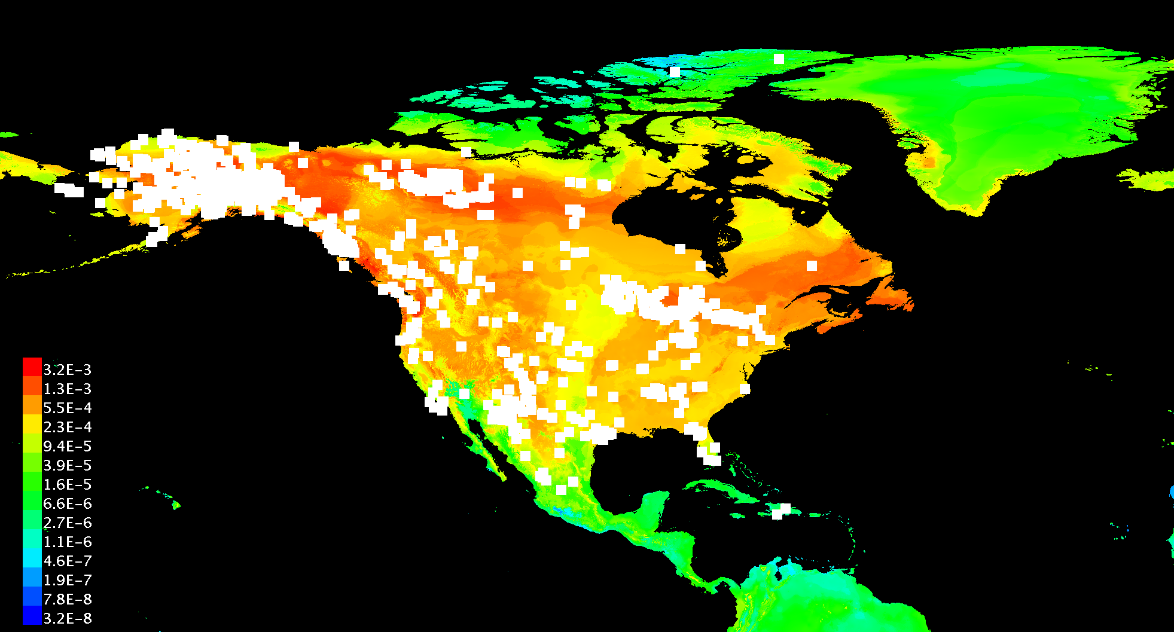
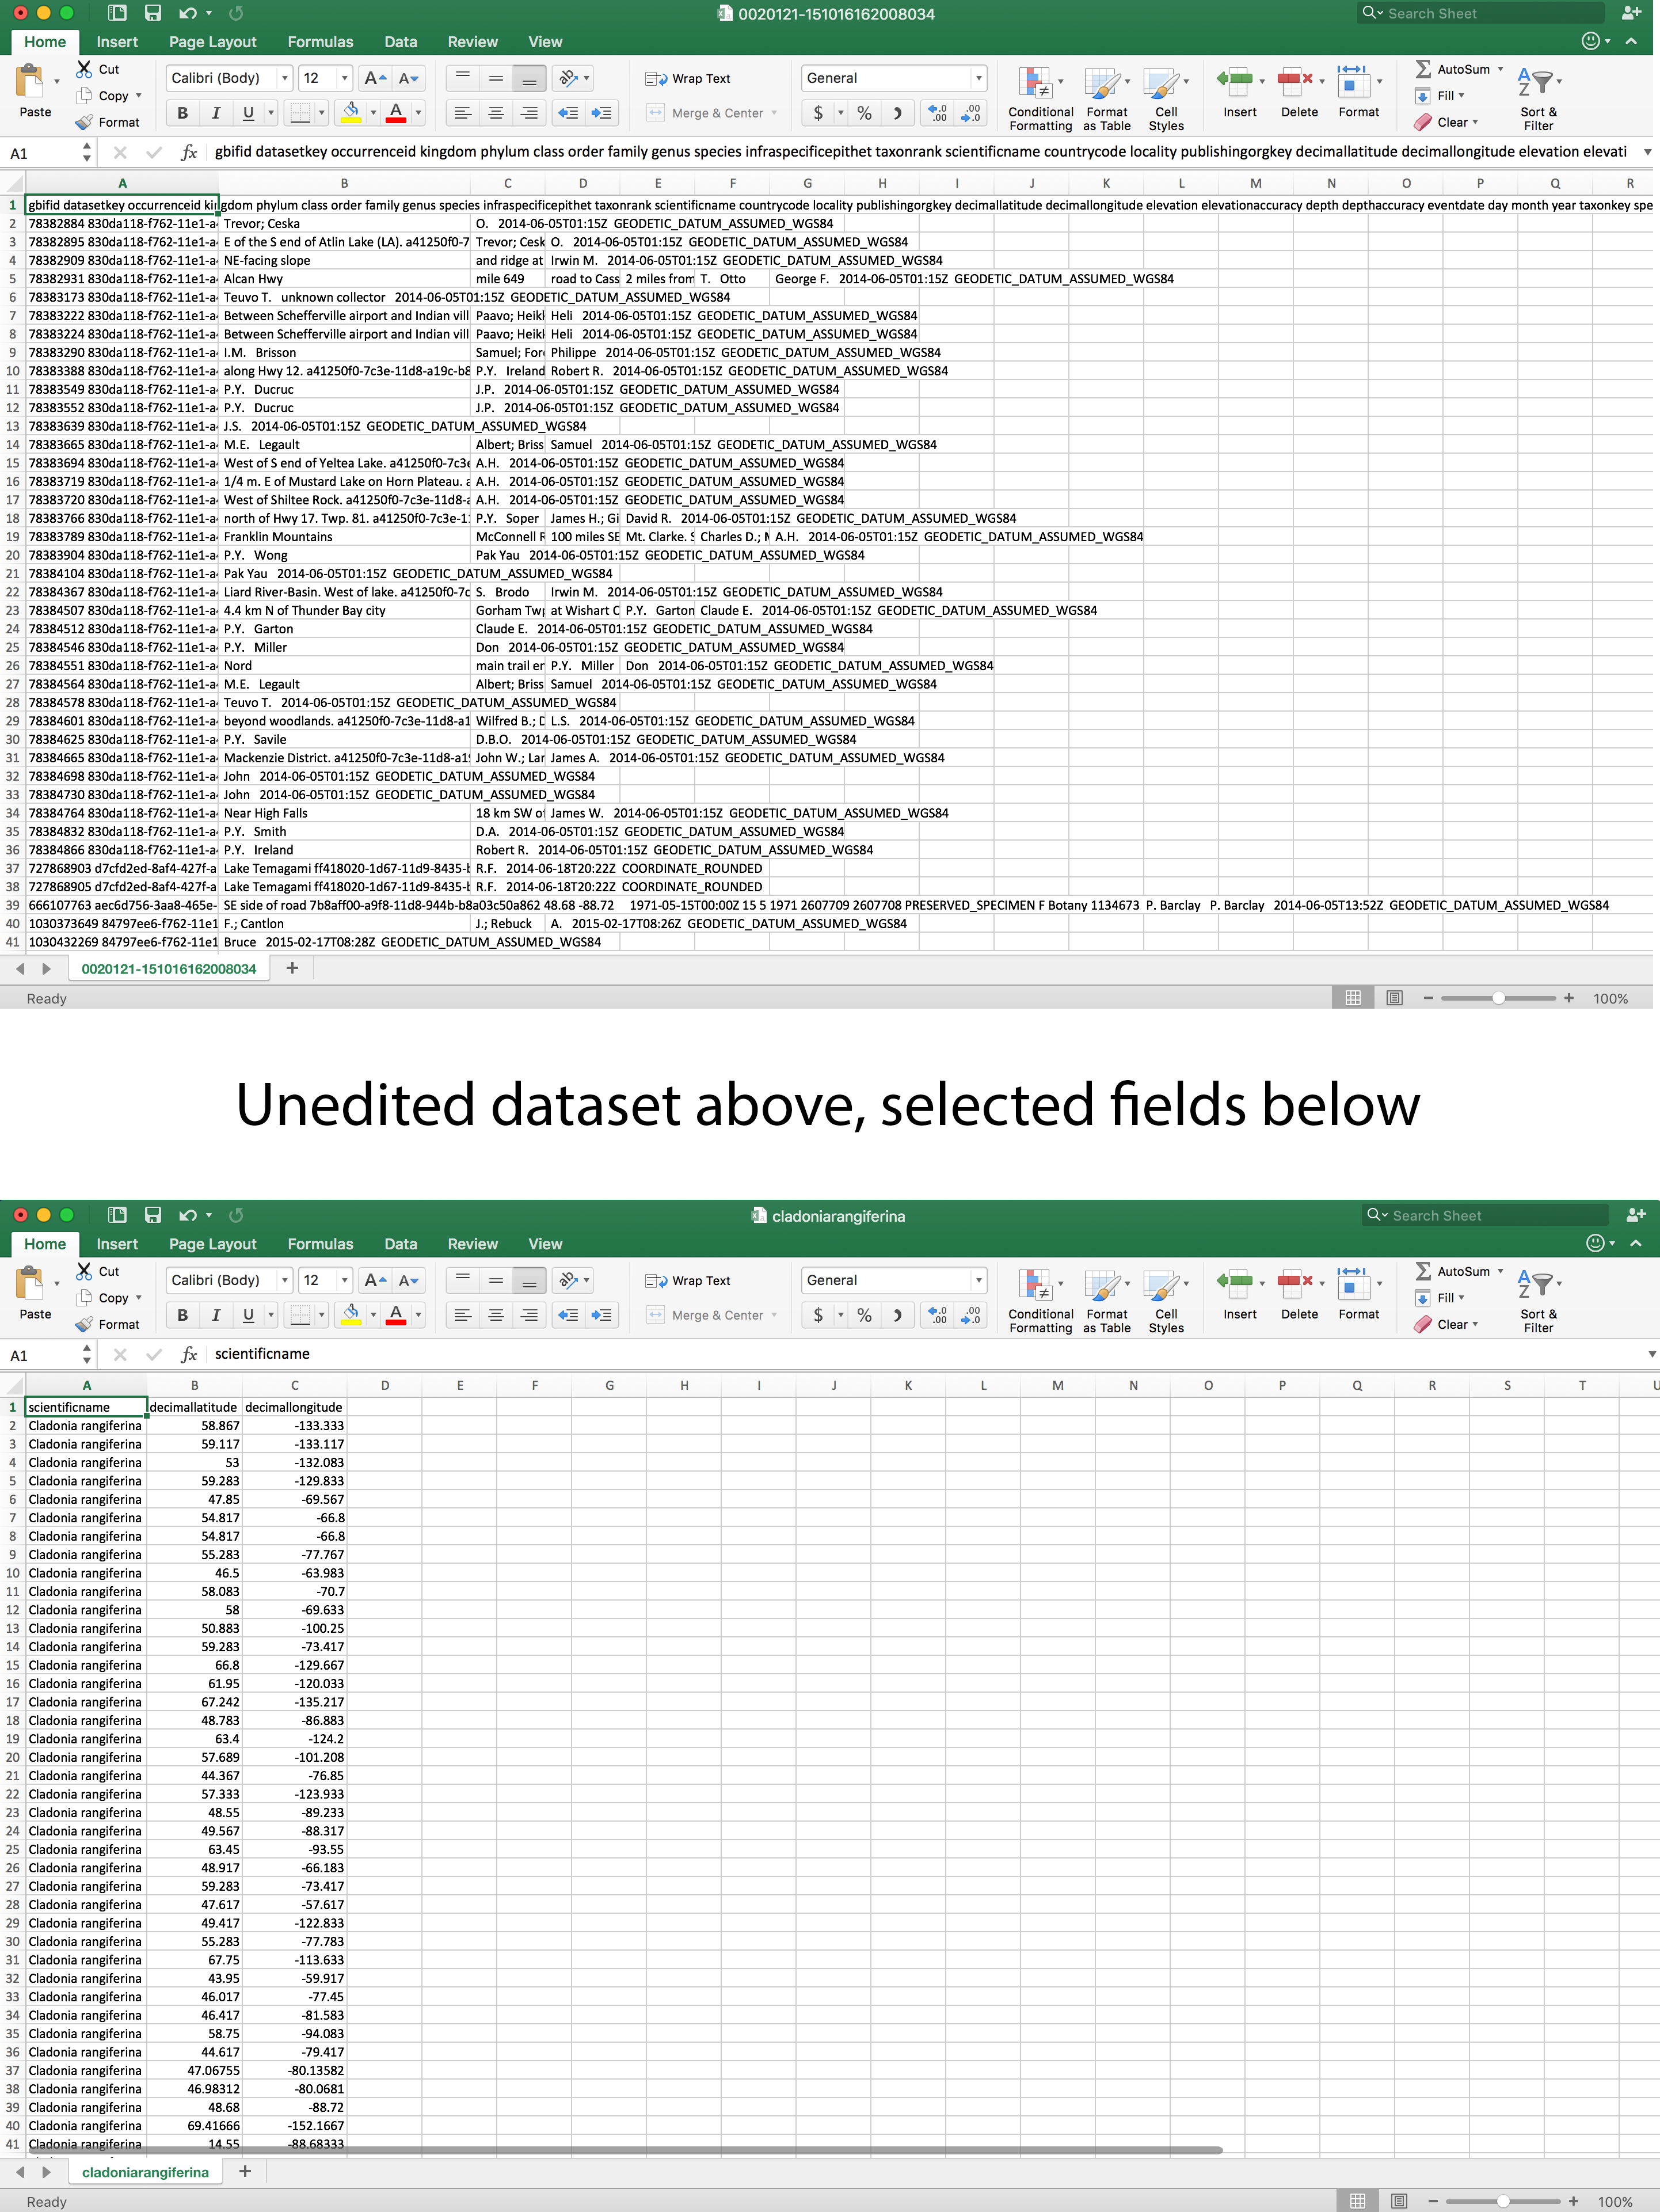
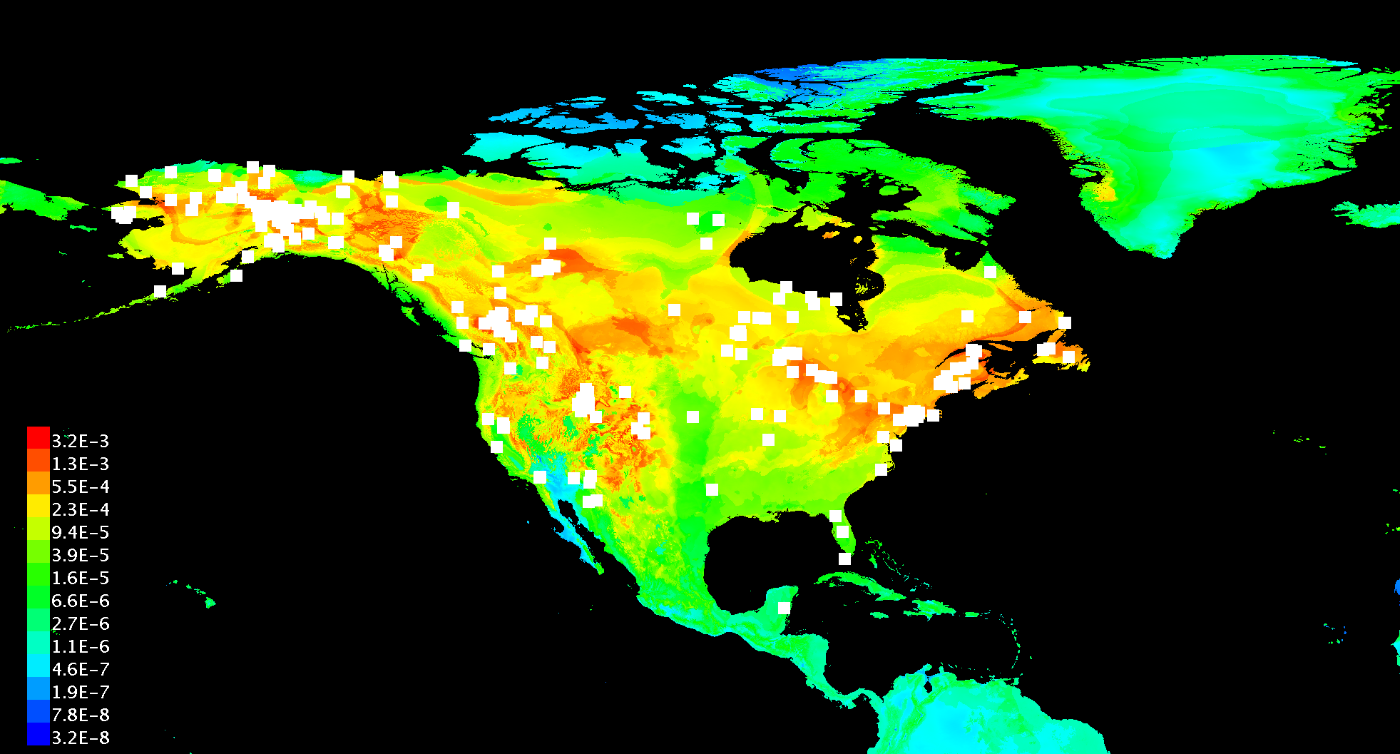
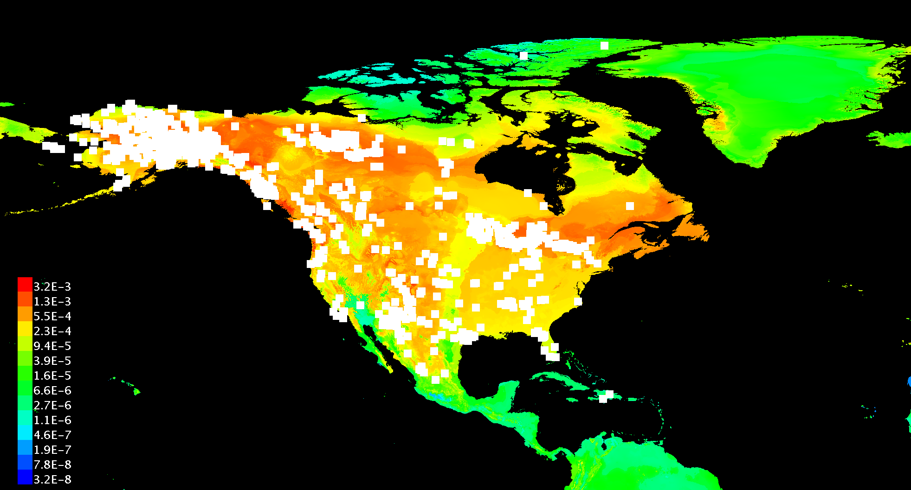
Effect of climate change on the distribution of Caribou (Rangifer tarandus)
Maximilian Alverson and Maksim Trifunovski
Wesleyan University
ABSTRACT
In order to predict the distribution of each of our three species of interest in the year 2070, we used maximum entropy modeling (MaxEnt). We used current global climate data as well as future global climate predictions obtained from worldclim.org. We decided to use the following four climate variables: Annual Mean Temperature, Precipitation Seasonality, Precipitation of Driest Quarter and Precipitation of Warmest Quarter. These variables should account for the main differences in climate between now and 2070, and should therefore have an impact on the possible distributions of all three of our species. The climate data was downloaded from worldclim.org in raster format, which was then converted to ASCII (.asc) format using the ArcGIS software. We chose to download data for 2.5 arc-minute resolution, which gives detailed data for a small area while keeping the file size manageable. For the future climate data, we chose to download data from the BCC-CSM1.1 climate model, following the RCP85 trajectory.
Current distribution of Cladonia rangiferina in North America:
CONCLUSIONS
Caribou refers to the North American subspecies of Rangifer tarandus, also known as the Reindeer in Europe and Asia. North American populations of caribou primarily inhabit the tundra and boreal forest ecosystems, presently ranging from Alaska across most of northern Canada. The gray wolf (Canis Lupus) is the primary predator of caribou, and is found in much of the same habitat as the caribou. On the other hand, caribou’s main food, especially during winter when other food sources are not available, is fruticose deer lichen (Cladonia rangiferina), and it is also found in much of the same habitat. Because arctic environments and the species inhabiting them are particularly vulnerable to the effects of climate change, the natural distributions of the caribou, the gray wolf and the reindeer lichen are expected to change in the near future due to the adverse effects of climate change. To analyze the effect of climate change, climate data variables such as temperature and precipitation, are measured at present time and by using climate models to predict the conditions in 2070.
Using maximum entropy (Maxent) species distribution modeling, we examine the current distribution of Rangifer tarandus, Canis Lupus and Cladonia rangiferina on the continent of North America, predict the possible distribution in 2070, and attempt to explain the various factors that influence the distribution of caribou, gray wolves and reindeer lichen. The results show us that the suitable habitat area of the Caribou shrinks by quite a lot, while the habitat of the gray wolves and the lichen remain almost the same.
Distribution of reindeer lichen will remain the same.
Distribution of gray wolves does not change a lot from climate change factors.
Caribou distribution does change; it decreases across all of North America.
Climate change will lead to warmer year round temperatures and slightly increased precipitation, especially in winter.
Other factors besides climate that affect Caribou distribution are:
Increasing human activities
Increasing competition from other species (Moose, Deer)
The Canis Lupus distribution will realistically be smaller than what our future results indicate because of lack of prey and increasing human interaction.
Higher summer temperatures lead to more insect harassment of Caribous.
Warmer and earlier spring can disrupt Caribou life cycle and limit access to food sources.
Higher precipitation in winter can hinder Caribou mobility and access to food sources such as Cladonia rangiferina.
Expected habitat of Cladonia rangiferina in year 2070:
METHODS
REFERENCES
We gathered the caribou and gray wolf current data from vertnet.com, and the Cladonia rangiferina data from gbif.org (Global BiodiversityInformation Facility). From the downloaded datasets in .tsv format, only the latitude and longitude coordinates were used to create the current distributions of all three species. These distributions were also filtered to only consider location data for North America, as all three species can also be found elsewhere with similar ecosystems, such as Eurasia.
Janet Brotton and Geoffrey Wall. Climate change and the Bathurst caribou herd in the Northwest Territories, Canada. Climatic Change, 35, 1997. http://link.springer.com/ article/10.1023/A:1005313315265.
M. Festa-Bianchet, J.C. Ray, S. Boutin, S.D. Coˆte ́, and A. Gunn. Conservation of cari- bou (Rangifer tarandus) in Canada: an uncertain future. Canadian Journal of Zoology, 89, 2011. http://www.nrcresearchpress.com/doi/abs/10.1139/z11-025#.Vl_ 9ot- rTdT.
IPCC. Climate, environment and socio-economic state. https://www.ipcc.ch/ publications_and_data/ar4/wg2/en/ch15s15-2.html#15-2-1.
IPCC. Scenario process for ar5. http://sedac.ipcc-data.org/ddc/ar5_scenario_ process/RCPs.html, 2014.
ElizabethA.Lenart,R.TerryBowyer,JayVerHoef,andRogerW.Ruess.Climatechangeand caribou: effects of summer weather on forage. Canadian Journal of Zoology, 80, 2002. http: //www.nrcresearchpress.com/doi/abs/10.1139/z02-034#.Vl_9yd-rTdR.
USFS. Cladonia (Cladina) spp. http://www.fs.fed.us/database/feis/lichens/ claspp/all.html.
USFS. Rangifer tarandus. http://www.fs.fed.us/database/feis/animals/ mammal/rata/all.html.
USFS. Wildlife species: Canis lupus. http://www.fs.fed.us/database/feis/ animals/mammal/calu/all.html.
RESULTS
Current distribution of Caribou in North America:
Current distribution of Canis Lupus in North America:
Expected habitat of Caribou in year 2070:
Expected habitat of Canis Lupus in year 2070:
ACKNOWLEGEMENTS
We would like to thank Professor Fred Cohan and Professor Danny Krizanc for a great class and a great semester.

